Slide 1
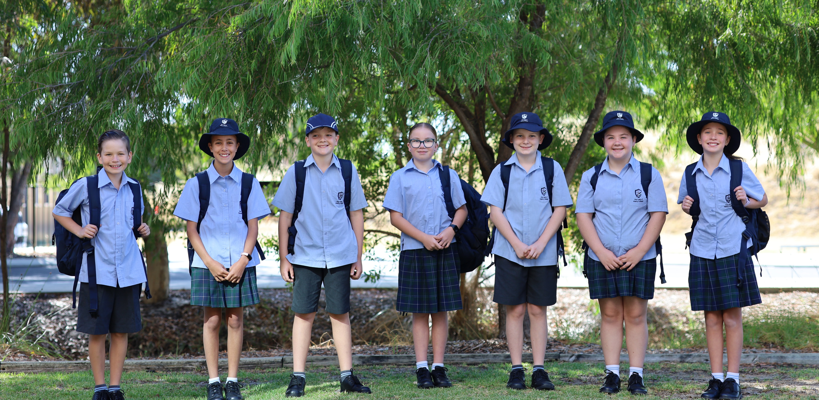
Name of Event

Slide 2
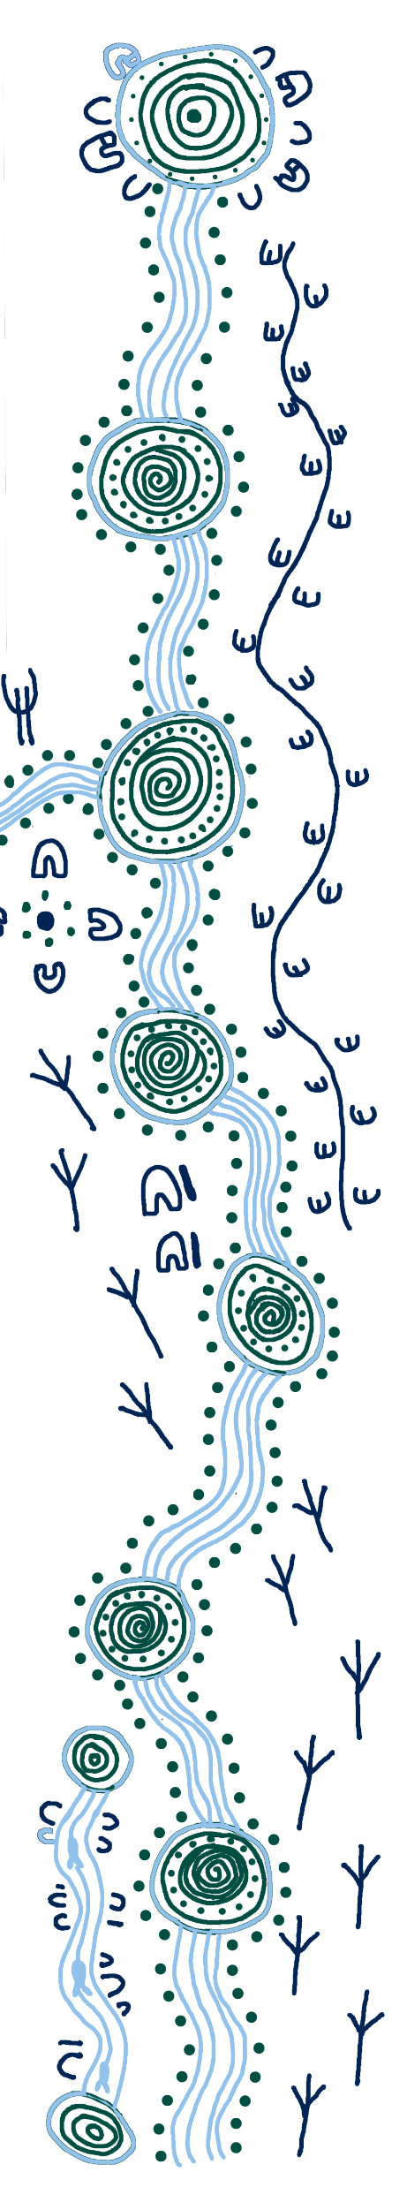
Acknowledgement of Country
We acknowledge the Bindjareb People of the Noongar Nation, the traditional custodians who have walked upon and cared for this land for thousands of years.
We acknowledge the continued deep spiritual attachment and relationship of First Nations Peoples to this country and commit ourselves to the ongoing journey of reconciliation.

Slide 3

The Mercy Values

Slide 4

We show Justice when we:
Act with integrity by choosing to do what is right
Are fair-minded
Stand up for those who are disadvantaged or excluded
Display equity in the way we treat others
Recognise the rights of others
Notes:
Our school value for 2026 is Justice.

Slide 5
Justice Prayer
God of love
Your Son taught us to uphold Justice
by caring for one another and ensuring fairness for all.
Ignite in us a deep commitment to follow His example.
Grant us eyes to see injustices,
ears to hear the cries of the vulnerable
and hands to be of service.
Notes:
Please join me in our Prayer for Justice. We start with the sign of the cross.

Slide 6
Justice Prayer
May we work together for the common good,
ensuring no one is left behind.
Give us courage to defend human dignity
and the strength to act with integrity.
May we be a voice for the voiceless and a light
for justice and peace.
Amen

Slide 7
Principal
Mr Vince Bellini

Slide 8
Head of Year 7
Head of Year 7
Mrs Joanne Ball

Slide 9

Our Houses
Pastoral Care

