Slide 1

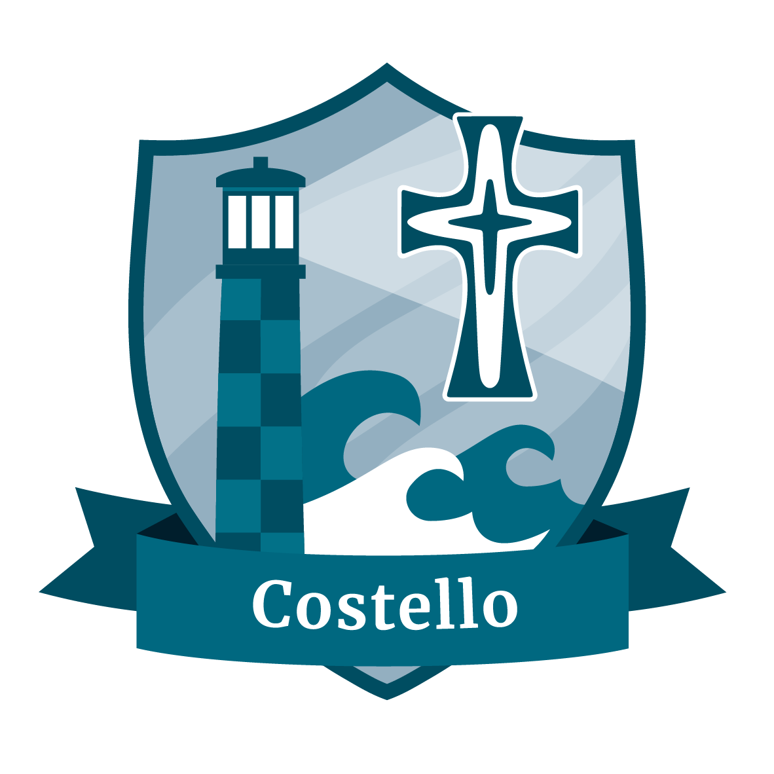
^{Guide, Inspire & Uphold}

Slide 2


Slide 3
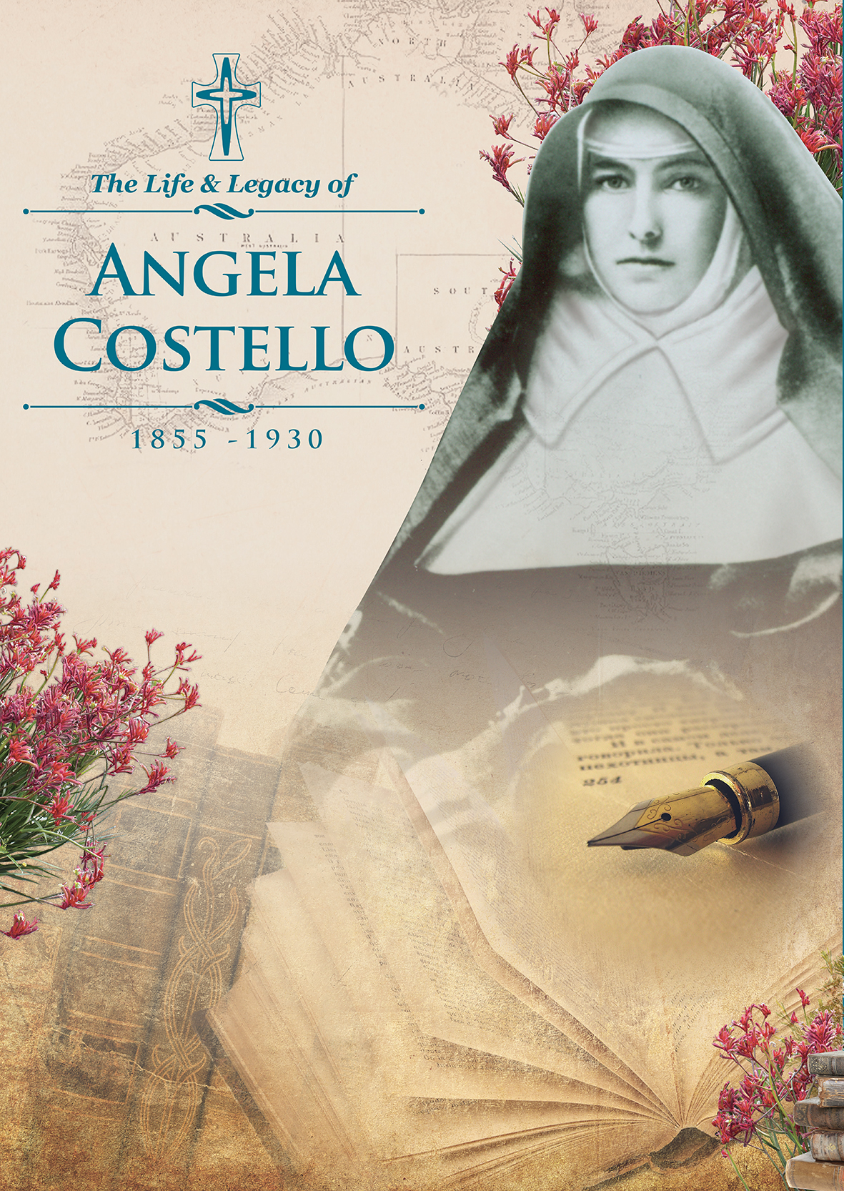

Slide 4
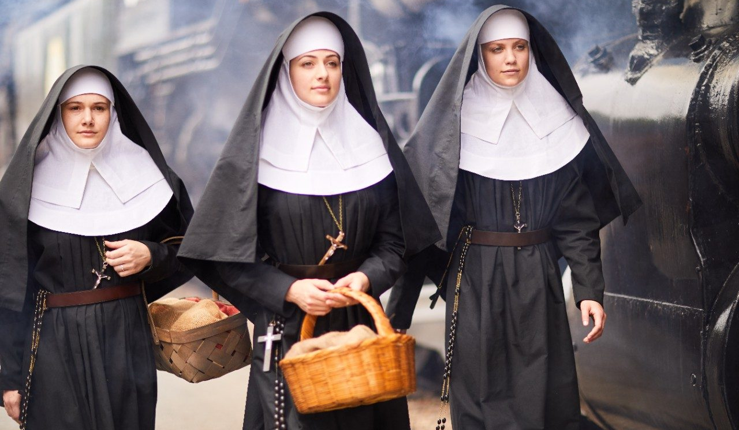

Slide 5

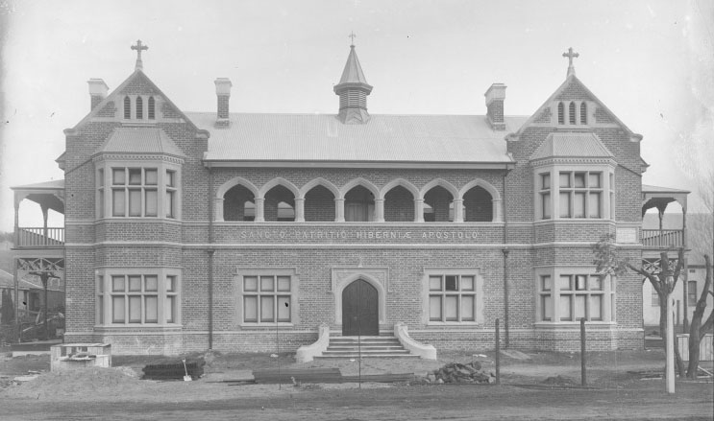
Biography
Born: in 1855 in Bunbury
Began teaching in Dardanup in 1871
Professed as Mercy nun: 1880
Died: 1930
^{Guide, Inspire & Uphold}

Slide 6
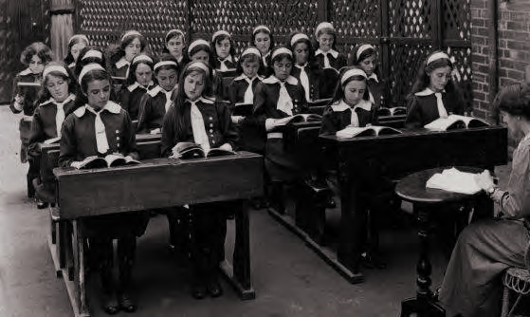
Life as a Mercy Sister
After professing as a Mercy nun, Sr Angela Costello was sent to St Vincent’s Boys’ Orphanage in Subiaco where she taught for 14 years.
She was appointed as Mother Superior to the Bunbury Convent in 1897
^{Guide, Inspire & Uphold}

Slide 7
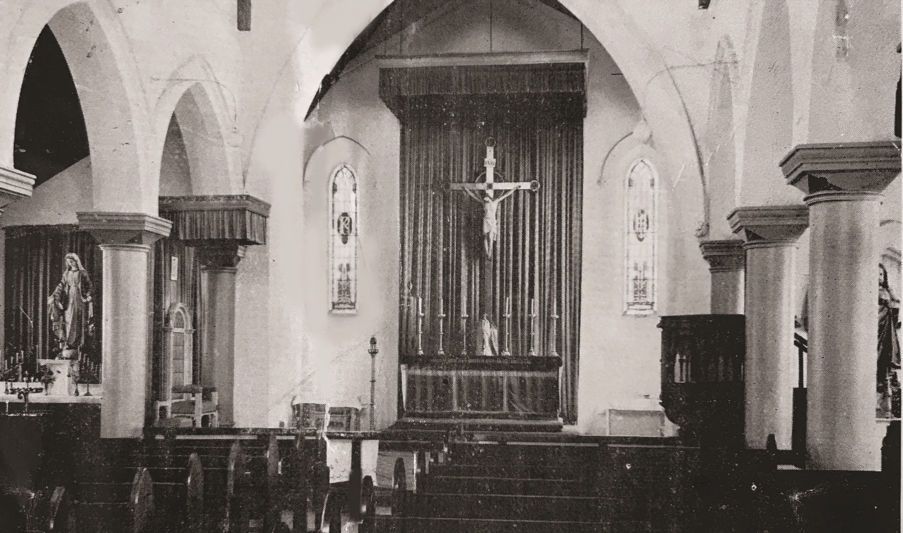
Life as a Mercy Sister
1899 Sacred Heart High School in Bunbury was opened under Sr Angela’s leadership
She remained as Reverend Mother or Mother Assistant of the Bunbury Convent until 1928
^{Guide, Inspire & Uphold}

Slide 8
Skills and Attributes
Achievements:
First Mother Superior of the Mercy Convent in Bunbury
Established Sacred Heart High School
Led a number of building programs which expanded the convent and school buildings
Voted in as Reverend Mother or Mother Assistant until 1928
^{Guide, Inspire & Uphold}

Slide 9
Skills and Attributes
Attributes:
Strong motivator
Respected for her integrity and administrative ability
Accomplished teacher
Firm disciplinarian
Maintained high academic standards
^{Guide, Inspire & Uphold}

Slide 10
Prayer
Lord,
Sr Angela Costello was a motivating force in establishing Mercy education in the south-west region, particularly in Dardanup and Bunbury.
She encouraged her students by setting high standards and showed a genuine love for the poor.
Inspire us to follow the example of Sister Costello by encouraging others through our words and actions.
May we show people that they are valued, loved and appreciated for who they are.
Amen
^{Guide, Inspire & Uphold}

