Slide 1
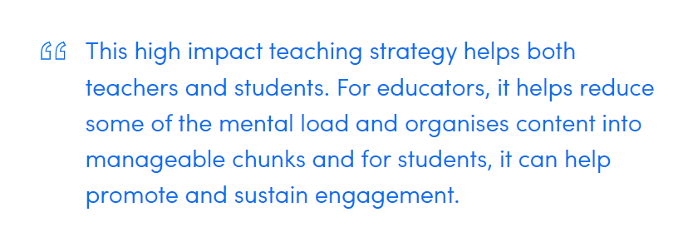
HITS – Setting Goals and Structuring Lessons ‘implementing the fundamentals’ (some AFL commentator)

Slide 2
Structuring Lessons

Slide 3
What it looks like?

Slide 4
What it doesn’t look like

Slide 5
What it looks like for students?

Slide 6
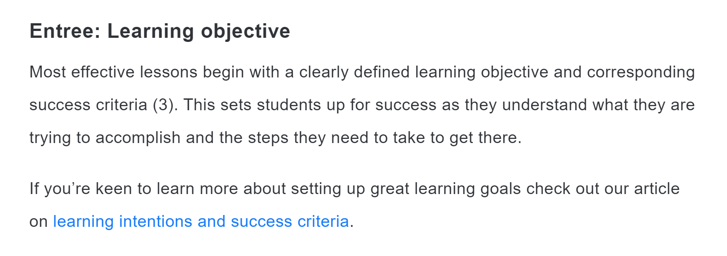
Structuring Lessons – think about a dinner out
ENTREE
Creating well-structured lessons (getatomi.com)

Slide 7
MAIN

Slide 8
DESSERT

Slide 9
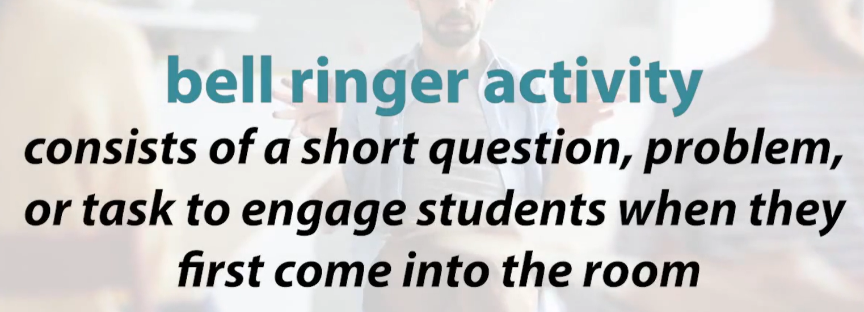
Tips for creating a well structured lesson
Rhythm and routines – Students thrive on consistency and once they know what to expect from each lesson you may even find student behaviour becomes more positive, time spent on task increases, and transitions between activities are less stressful.
Bell Ringers – Firstly, it allows the teacher time to do some administration and get the learning intentions up and ready to go. Secondly, it settles students into the classroom and gets them prepped for learning. Often with the inclusion of bell ringers educators find that student behaviour at the beginning of class is much easier to manage. Finally, students know what to expect and have dedicated space to get their minds ready for learning.

Slide 10
Tips for creating a well structured lesson cont…
3. Learning Intentions - provides students with a clear understanding of what they are trying to learn.
4. Scaffolds - During the main portion of each lesson, students are given a variety of different tasks. They may be required to create a mind map, write a summary, solve problems, or complete a creative task. We don’t want this to become repetitive for students. So while we are always striving for consistent structure, we don’t want our lessons to become boring.

Slide 11
And finally…. (but not the final slide!)
5. Exit strategies - They not only wrap up the lesson and link students back to the learning objectives, but they also help educators obtain formative feedback on student progress.
There are many ways to include this strategy. Ask students to write down:
3 things they learnt
2 questions they have
and 1 thing they are confused about.
If this is too involved for every lesson, you can also ask students to rate their confidence from 1-5 at the end of each lesson by holding up the corresponding number of fingers. While this won’t give you specific information, it’s a great tool to collect student attitude feedback quickly and easily!

Slide 12
Setting Goals

Slide 13
Setting Goals - Learning Intentions and Success Criteria
A Learning Intention clearly outlines what the teacher wants the students to know, understand and be able to accomplish as a direct result of planned teaching and learning activities.
Success Criteria describes what achievement looks like. It must be planned in advance and linked to the Learning Intention.

Slide 14
Tips on effective Learning Intentions
It is not about tasks you want the students to complete but what you want them to learn and understand.
Take time to sit and plan about what you want students to learn throughout the lesson.
If needed narrow the learning focus into smaller manageable chunks.
This is a great opportunity to differentiate your lesson by providing tiered learning intentions and success criteria. You can articulate this using a colour system or providing different wording choices such as “all, most and some”.

Slide 15
Tips on effective Success Criteria
The easiest way to implement success criteria effectively is to show students what success looks like.
For example, if students are working on a maths problem, show them the answer and then have them work out the strategy from there.
If you are asking students to create a presentation, show them what a top-mark response looks like, as well as modelling what middle and low-range responses are.
By doing so, students can very clearly see what they need to do to be successful.
To formalise this you can create a success criteria checklist. This would include all of the steps students need to take or include to achieve full marks. Using wording like “I can” statements can help to motivate students and foster a more positive experience.

Slide 16
What Learning Intentions and Success Criteria look like.

Slide 17
What Learning Intentions and Success Criteria look like.

Slide 18
Want more information?
Check out the Staff Hub for this presentation and others
Check out the Australind Team for a new resource from ATOMI thanks to Catherine Griffin.

