Slide 1


^{Honesty, Hope & Humility}

Slide 2


Slide 3
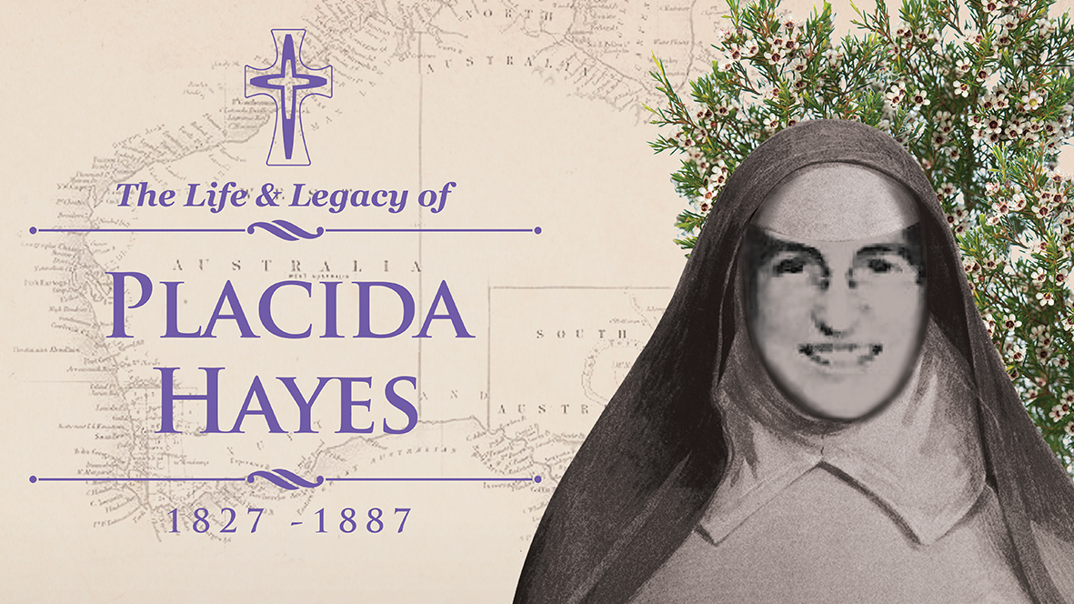

Slide 4
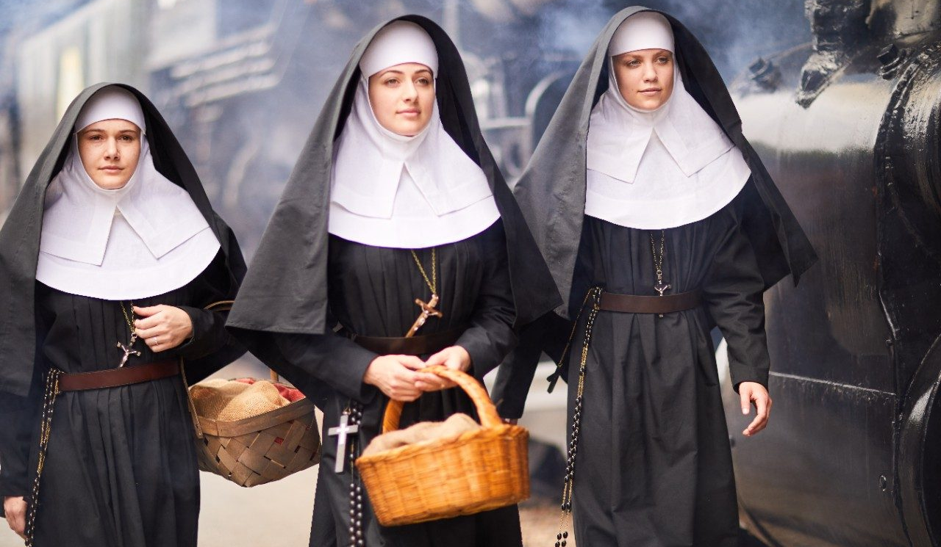

Slide 5

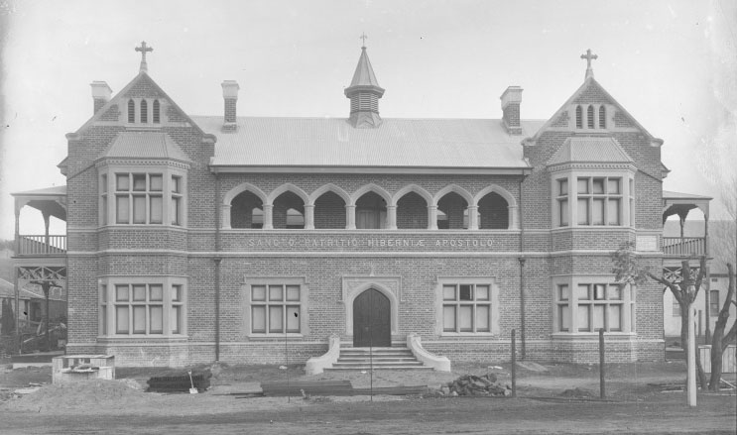
Biography
Born: in 1827 in Australia
Parents of Irish Heritage
Professed as Mercy nun: 4 September 1853
Died: 1887
^{Honesty, Hope & Humility}

Slide 6
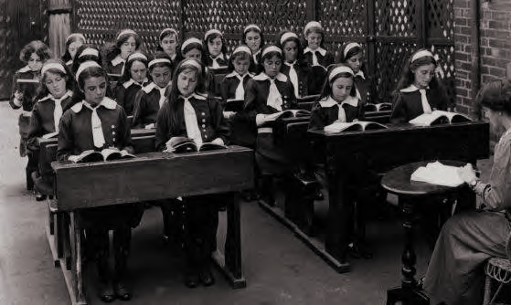
Move to Bunbury
Fr Hugh Brady invited Mercy sisters to Bunbury to establish a convent and Catholic school
Bunbury lacked schools offering formal education for children in the town and district
June 1883 Hayes and two other sisters from the Mercy Convent Perth, travelled to Bunbury via ship.
^{Honesty, Hope & Humility}

Slide 7
Skills and Attributes
Achievements:
Established the first Mercy Convent in the South West.
Involved in fundraising and planning for Mercy schools in Bunbury – first opened in 1850, second larger school built in 1884
^{Honesty, Hope & Humility}

Slide 8
Skills and Attributes
Attributes:
“Her strong spirit persevered through testing times.”
“Her faith and trust in God enabled her vision to flourish.”
“The result of her zeal” is evidenced in the construction of the Mercy Convent and school buildings.
^{Honesty, Hope & Humility}

Slide 9
Prayer
Lord,
Sr Placida Hayes faced many challenges in endeavouring to establish a formal education for children in the Bunbury region, during the 1880s.
Our College is evidence of her enthusiasm in fulfilling this mission and we give thanks for her persistence.
Let us follow Sr Hayes’s example when we too, face challenges in our own lives.
Help us to turn our spirit towards you so that we can find strength to overcome obstacles.
Forgive our doubts and fears and fill us with your love and strength.
In Jesus’ name.
Amen
^{Honesty, Hope & Humility}

